Slide 1

Intro to Python for Security

Slide 2

> whoami
{
name: ‘Mikael Magnuson’,
rank: ‘MAJ’,
occupation: ‘cybers’,
kids: {
clara: 2,
miles: 11,
ellis: 8
},
spouse: ‘Bethany’,
hobbies: [
‘programming’,
‘golf’,
‘leadership’
]
}

Slide 3
Agenda for this class
Day 1:
Installing Python
Introduction to the Python interactive terminal
Variables
Start on “What is Python”?
Day 2:
“What is Python?” - continued
Python as a calculator
Common Data Structures
Built-ins and Key Words
Day 3:
Flow control
Writing functions
Writing Scripts
Starting our project
Day 4:
Completing the project
Notes:
Don’t expect that I’ll have a bunch of slides. For the week of class, I have a total of 15 slides. That’s going to last us probably 30 hours of instruction.
For this first hour or so, just bear with me because there are going to be some slides. This is just so I can describe some theory concepts rather than the practical side of it.
But most of this class will be practical in nature.
So, this won’t be death by powerpoint. This is going to be very interactive. For most of the class, you’ll be looking at my terminal or my vscode.
Hopefully, you’ll be following along with me and doing the same things so you can learn by doing.

Slide 4
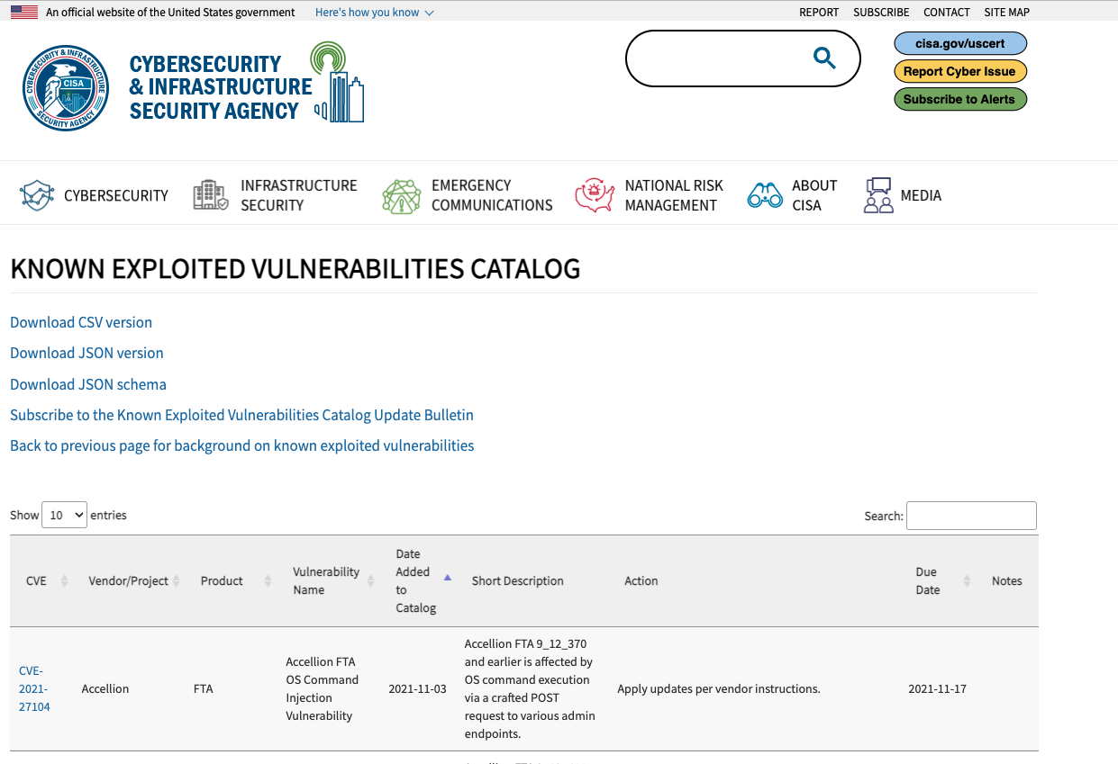
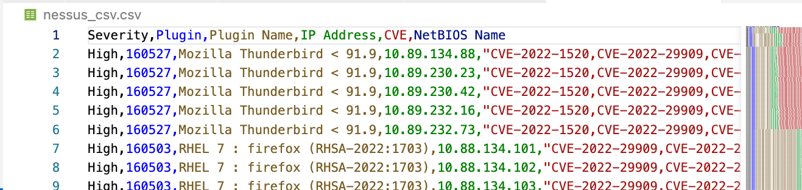
The output of this course
Merge these two things programmatically to be able to report the vulnerabilities in your network as a prioritized list to executives.

Slide 5
Key Learning Objectives
Understand the basic principles of Python to write simple scripts.
Create functions to make your code more readable, re-usable, and testable.
Import libraries and use them to build high-functioning scripts quickly and easily.
Use common libraries to interact with data on the web and enrich applications.

Slide 6
So, let’s jump right in!
Installation – do you have it already installed?
Windows: try python --version OR python3 --version
Linux / MacOS: Same thing, or which python
If you don’t have it, let’s take a minute to install right now. Google Python download.
Python.org/downloads

Slide 7
Python Interactive Terminal
Let’s check out the python terminal
Just type python into your terminal window
Notes:
[ Add a screenshot of the python terminal ]
Go interactive
Print(“Hello World”)
Print(hello world)
Hello = ”Hello, World.”
Print(Hello)
Ok, so let’s talk a bit about what is going on here -
Builtins are the classes and functions that are built into the python language by default.
Keywords aren’t classes or functions, but are words that mean something to python.
Most high-level languages have both their own types of built-ins and keywords, but these differ from language to language.
Python has been criticized for doing things differently than other languages syntactically. For example, almost all languages call lists of things “Arrays,” but in Python they are called lists.
Let’s take a look at what is an object and what is a function instead.
Let’s use list and len as an example. You can see that they are both built-ins.
let’s just first explore what they are. If we just type len and list into the terminal, it will output what they are on the next line. This is the same if you type anything into the terminal. The terminal will just spit back out at you what it thinks that thing is or means.
Type 12
Type “Hello”
If something is undefined, the interpreter will give us an error.
Type Hello
So, let’s try typing len and list
By doing so, we can see that they’re both defined and what the interpreter says that they are.
And although they are both “builtins”, we can see that there is a difference in what the interpreter says they are.
One is a class and one is a built-in function.
So, what does that mean?
You can kind of think of it like this:
- A class is something. A class is the object in an object-oriented programming language. We will get into this a bit more later. But for this example, you can think of list as simply that. It’s an object that is defined by python as representing a list of things.
- A function is something that does something. In this case, len is the built-in function that returns the length of something.
Let’s take a really simple example, then, using these two built-ins.
my_list = [‘a’, ‘b’, ‘c’]

Slide 8
Some early examples of things we can do
Some things we will do:
print(“hello world”)
dir(__builtins__)
import keyword
keyword.kwlist
Notes:
[ Add a screenshot of the python terminal ]
Go interactive
Print(“Hello World”)
Print(hello world)
Hello = ”Hello, World.”
Print(Hello)
Ok, so let’s talk a bit about what is going on here -
Builtins are the classes and functions that are built into the python language by default.
Keywords aren’t classes or functions, but are words that mean something to python.
Most high-level languages have both their own types of built-ins and keywords, but these differ from language to language.
Python has been criticized for doing things differently than other languages syntactically. For example, almost all languages call lists of things “Arrays,” but in Python they are called lists.
Let’s take a look at what is an object and what is a function instead.
Let’s use list and len as an example. You can see that they are both built-ins.
let’s just first explore what they are. If we just type len and list into the terminal, it will output what they are on the next line. This is the same if you type anything into the terminal. The terminal will just spit back out at you what it thinks that thing is or means.
Type 12
Type “Hello”
If something is undefined, the interpreter will give us an error.
Type Hello
So, let’s try typing len and list
By doing so, we can see that they’re both defined and what the interpreter says that they are.
And although they are both “builtins”, we can see that there is a difference in what the interpreter says they are.
One is a class and one is a built-in function.
So, what does that mean?
You can kind of think of it like this:
- A class is something. A class is the object in an object-oriented programming language. We will get into this a bit more later. But for this example, you can think of list as simply that. It’s an object that is defined by python as representing a list of things.
- A function is something that does something. In this case, len is the built-in function that returns the length of something.
Let’s take a really simple example, then, using these two built-ins.
my_list = [‘a’, ‘b’, ‘c’]

Slide 9
Let’s talk about variables
An easy representation of another object
This leads us into types of objects
integer (int)
string (str)
list
dictionary
set
tuple
thread, etc, etc, etc…

Slide 10
Some key take-aways
We can program directly into the terminal to see how things react before putting them into a script.
Python has a number of built-in things that we can take advantage of.
Python also has keywords
Functions are things that take an argument, do some computation, and output a result.
NOTE: Methods are different, but not much really. Don’t get wrapped around the axle on the difference between methods and functions.
Variables are representations for other things
Notes:
[ Add a screenshot of the python terminal ]
Go interactive
Print(“Hello World”)
Print(hello world)
Hello = ”Hello, World.”
Print(Hello)
Ok, so let’s talk a bit about what is going on here -
Builtins are the classes and functions that are built into the python language by default.
Keywords aren’t classes or functions, but are words that mean something to python.
Most high-level languages have both their own types of built-ins and keywords, but these differ from language to language.
Python has been criticized for doing things differently than other languages syntactically. For example, almost all languages call lists of things “Arrays,” but in Python they are called lists.
Let’s take a look at what is an object and what is a function instead.
Let’s use list and len as an example. You can see that they are both built-ins.
let’s just first explore what they are. If we just type len and list into the terminal, it will output what they are on the next line. This is the same if you type anything into the terminal. The terminal will just spit back out at you what it thinks that thing is or means.
Type 12
Type “Hello”
If something is undefined, the interpreter will give us an error.
Type Hello
So, let’s try typing len and list
By doing so, we can see that they’re both defined and what the interpreter says that they are.
And although they are both “builtins”, we can see that there is a difference in what the interpreter says they are.
One is a class and one is a built-in function.
So, what does that mean?
You can kind of think of it like this:
- A class is something. A class is the object in an object-oriented programming language. We will get into this a bit more later. But for this example, you can think of list as simply that. It’s an object that is defined by python as representing a list of things.
- A function is something that does something. In this case, len is the built-in function that returns the length of something.
Let’s take a really simple example, then, using these two built-ins.
my_list = [‘a’, ‘b’, ‘c’]

Slide 11
Python - What is it!?
A weakly typed, interpreted, object-oriented, high-level scripting language.
Whaaaat!?
Weakly typed – what does that mean!?
Interpreted – what does that mean!?
Object-oriented – what does that mean!?
High-level – what does that mean!?
Notes:
Scripting Language: It’s easy to use to complete tedious tasks. If you have a spreadsheet and you want to join two fields together, you can do so pretty easily using python for example. As we will see throughout this course, we will explore some simple things that you might want to do with Python in your daily lives.
Weakly-typed: implicit declaration of things – which means that errors aren’t caught until run-time, and things can change throughout the execution of the code.
Interpreted: Interpreted languages use a separate executable (an interpreter) to run the code that they are written in. So, in order to run python code, you must have some version of python installed on your system. The opposite of this is a compiled language, where the code is compiled into machine language that can then be transported to various platforms. Compiled languages can catch errors in logic during compile-time, whereas interpreted languages catch errors at run-time.
Object-oriented: The language is based around objects – (almost) everything is an object. Objects are higher level things that are stored in memory.
High-level: Many data structures and other things are already implemented for you. In low-level programming, the programmer needs to develop data structures and common algorithms for themselves, as well as do things like manage memory. In higher level languages, many things are already done for you. As an example, later in the course we will look at a sorting algorithm to show you the power of what is already implemented in Python.

Slide 12
Python as a calculator
+ - addition
- - subtraction
* - multiplication
** - exponents
/ - division (returns a float)
// - divide and then round down (floor - returns an integer)
% - modulus

Slide 13
Let’s look at some common data structures (and fun things you can do with them)
Boolean
Integer
Float
String
List
Tuple
Set
Dictionary

Slide 14
How about flow control with keywords?
if/elif/else statements
comparisons ==, is, is not, !=, <, >, <=, >=
while / continue / break
for / continue / break
try / except
Notes:
[Add in a screenshot of opening VSCode]
VSCode is my current favorite IDE. I’ve used things in the past before like PyCharm from JetBrains. It’s a really good IDE, and fully featured. It just costs a lot more than VSCode and I think for the price you pay, you don’t really get that much in return. Plus, it’s a much heavier program and is slower to update, etc.
That said, the beauty of Python is that you can basically use anything to write your code. Sublime text or Notepad++ or VIM if you’re a classic developer or just a notepad, for that matter.
This is really true for any language, I guess, but the syntax of Python makes it easy to work with no matter what you’re using.

Slide 15
Writing a function
def function_name(arg1, arg2):
# do some things here
something = result_of_calculations
return something

Slide 16
Writing a script
“””
Docstring - talk about what this script does
“””
import packages
def main():
#do something
if __name__ == “__main__”:
main()

